Slide 1
Lab5 - Graphic Equalizer
班級：電子三乙
學號：106360210
姓名：劉紹祥

Slide 2
Linear Phase FIR (designed using window function)
Source Code
Original audio file
Audio File after Equalizer
My Filter
GUI Interface
Contents

Slide 3
Linear Phase FIR (designed using window function)

Slide 4
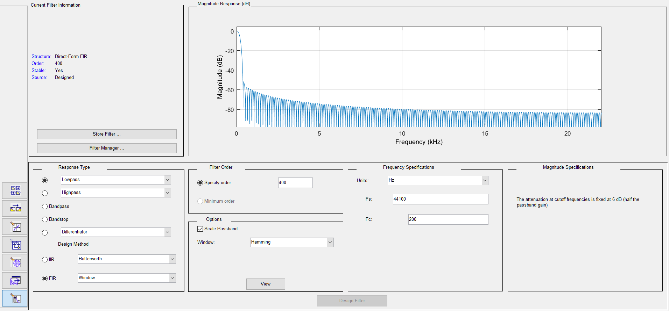
Lowpass (<200 Hz)

Slide 5
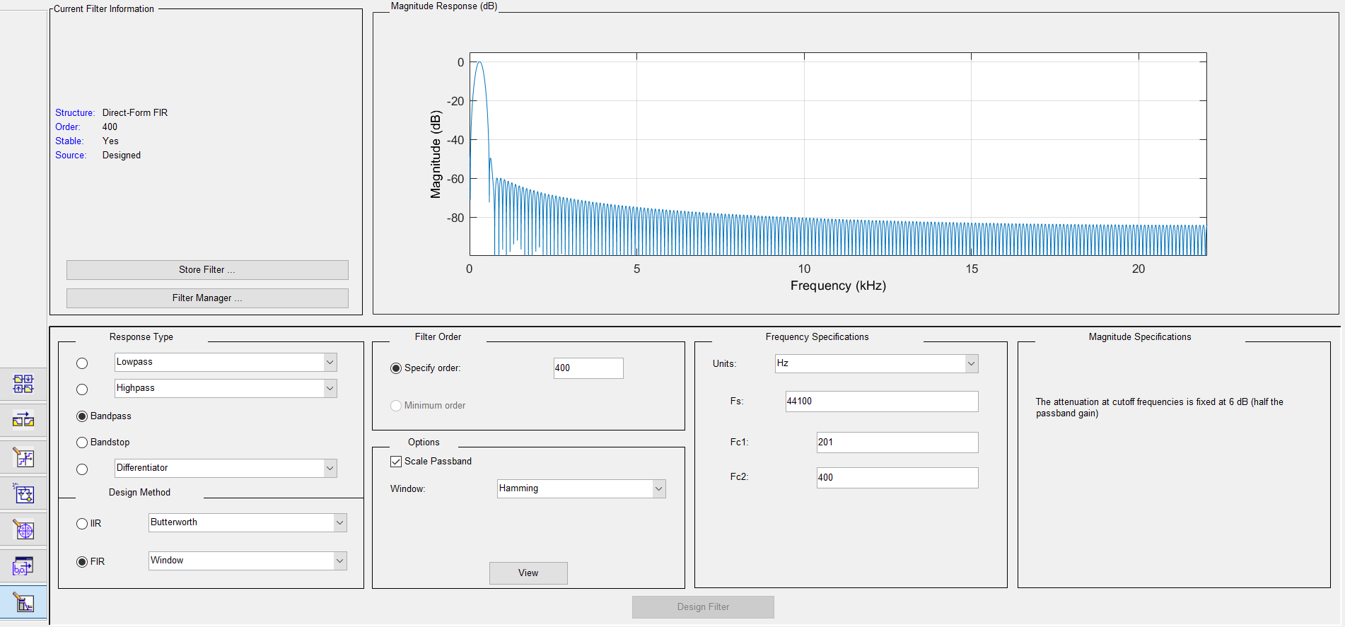
Bandpass (201-400Hz)

Slide 6
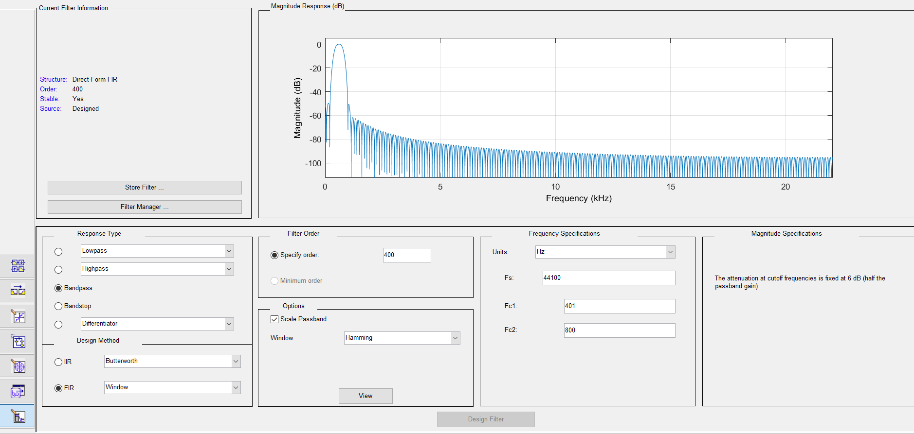
Bandpass (401-800 Hz)

Slide 7
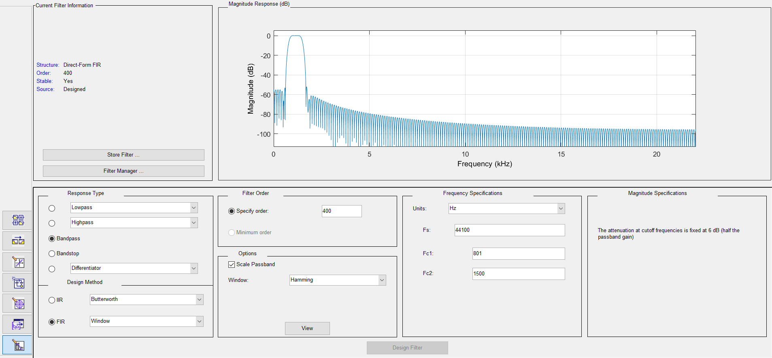
Bandpass (801-1.5 KHz)

Slide 8
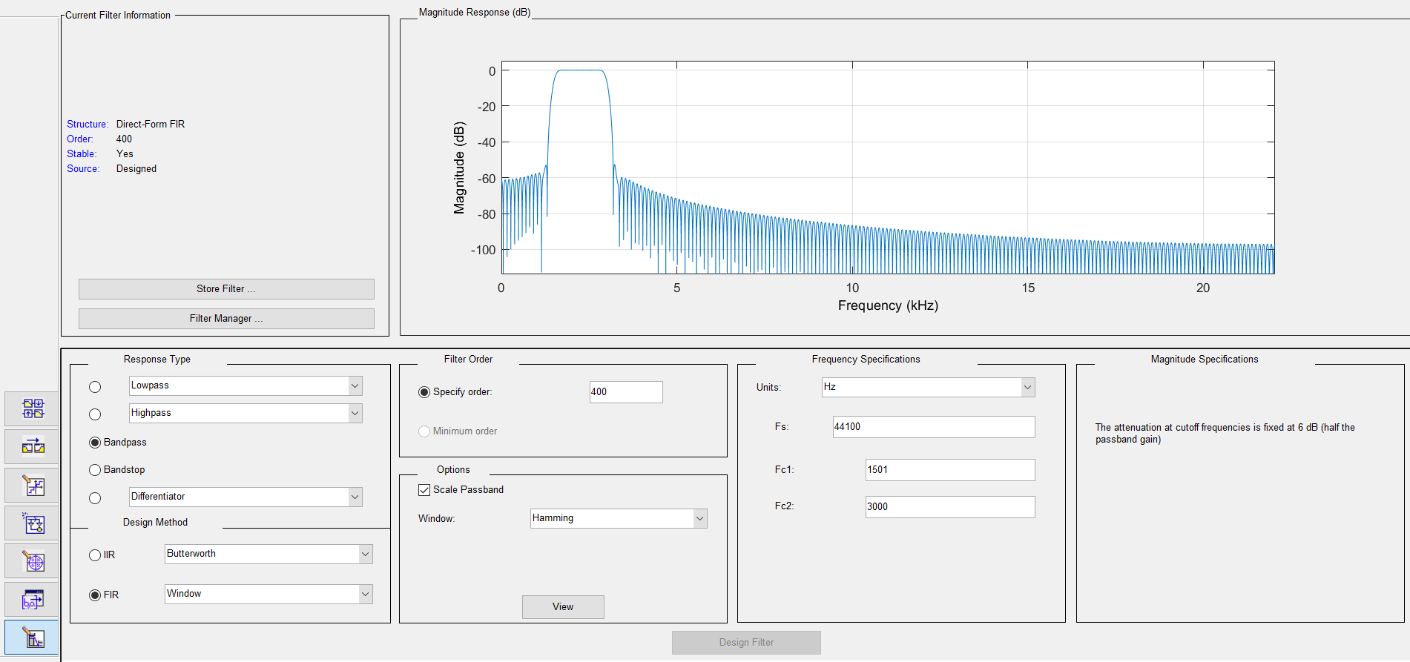
Bandpass (1.5-3 KHz)

Slide 9
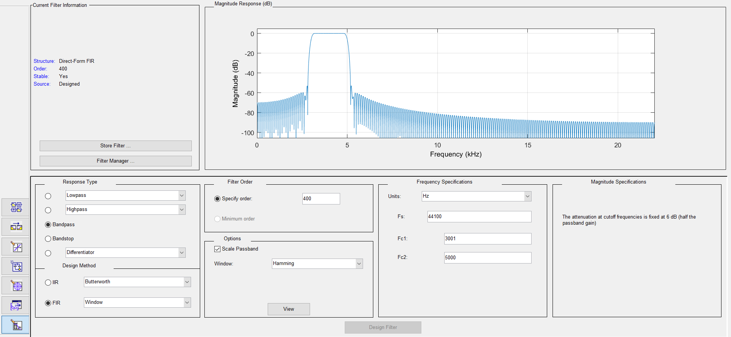
Bandpass (3-5 KHz)

Slide 10
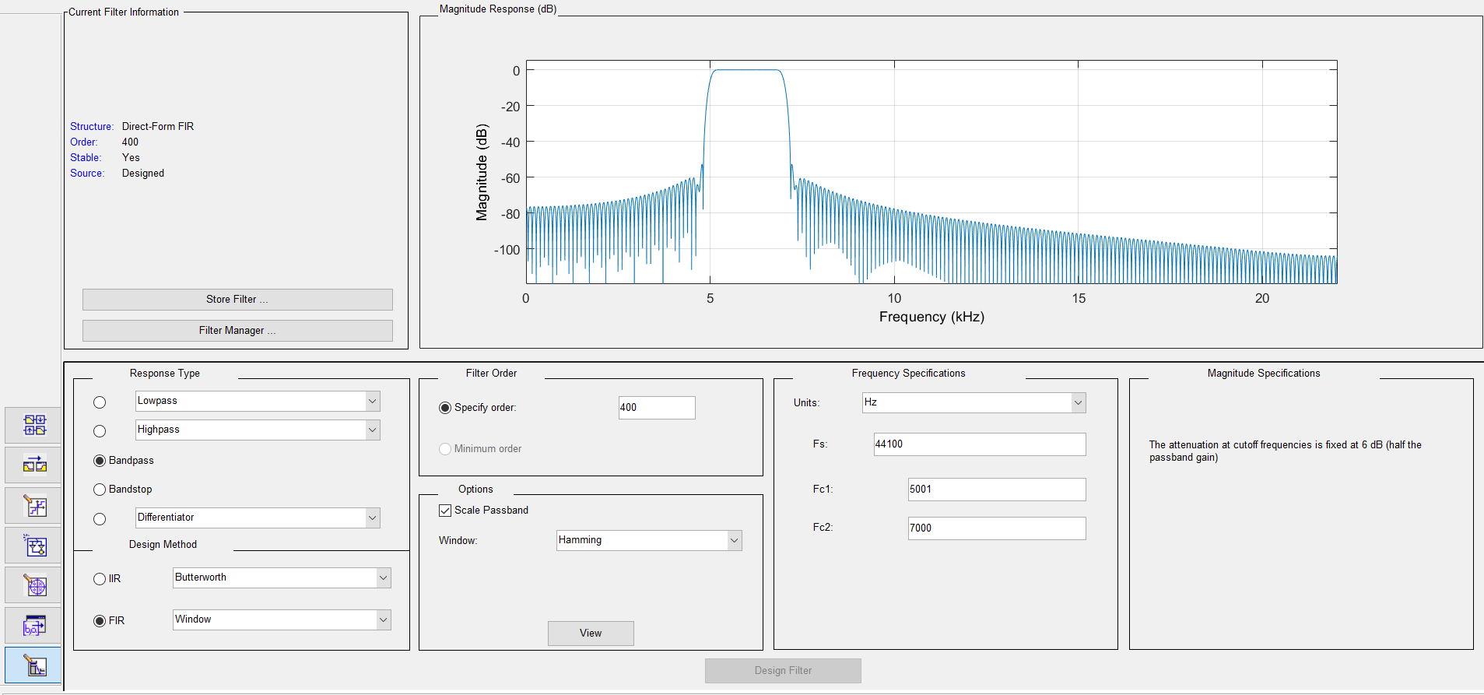
Bandpass (5-7 KHz)

Slide 11
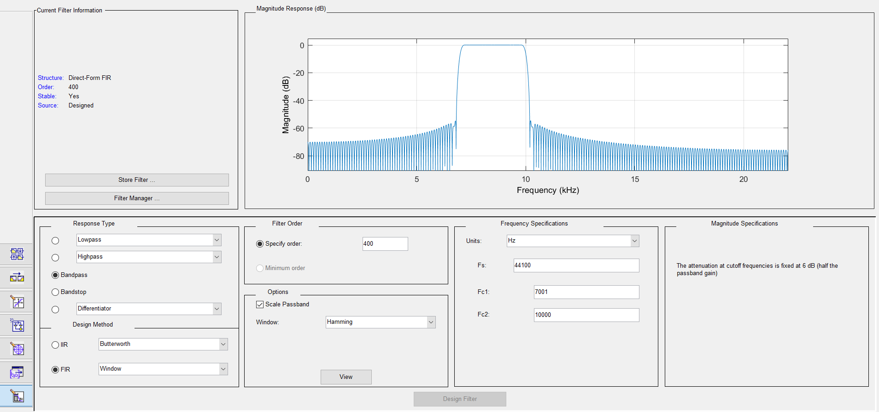
Bandpass (7-10 KHz)

Slide 12
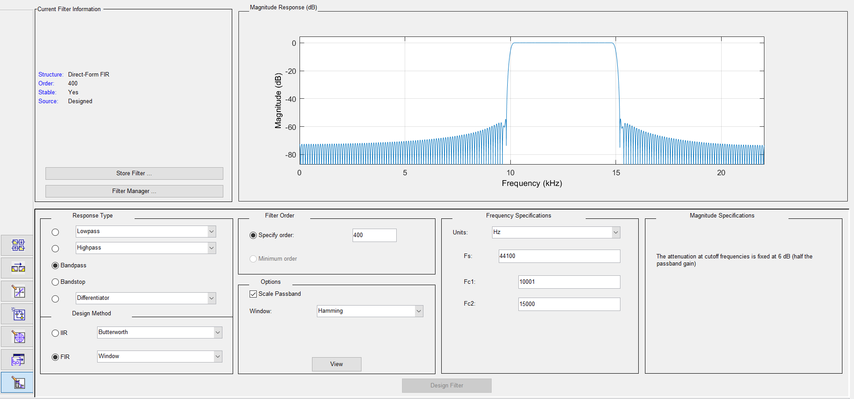
Bandpass (10-15 KHz)

Slide 13
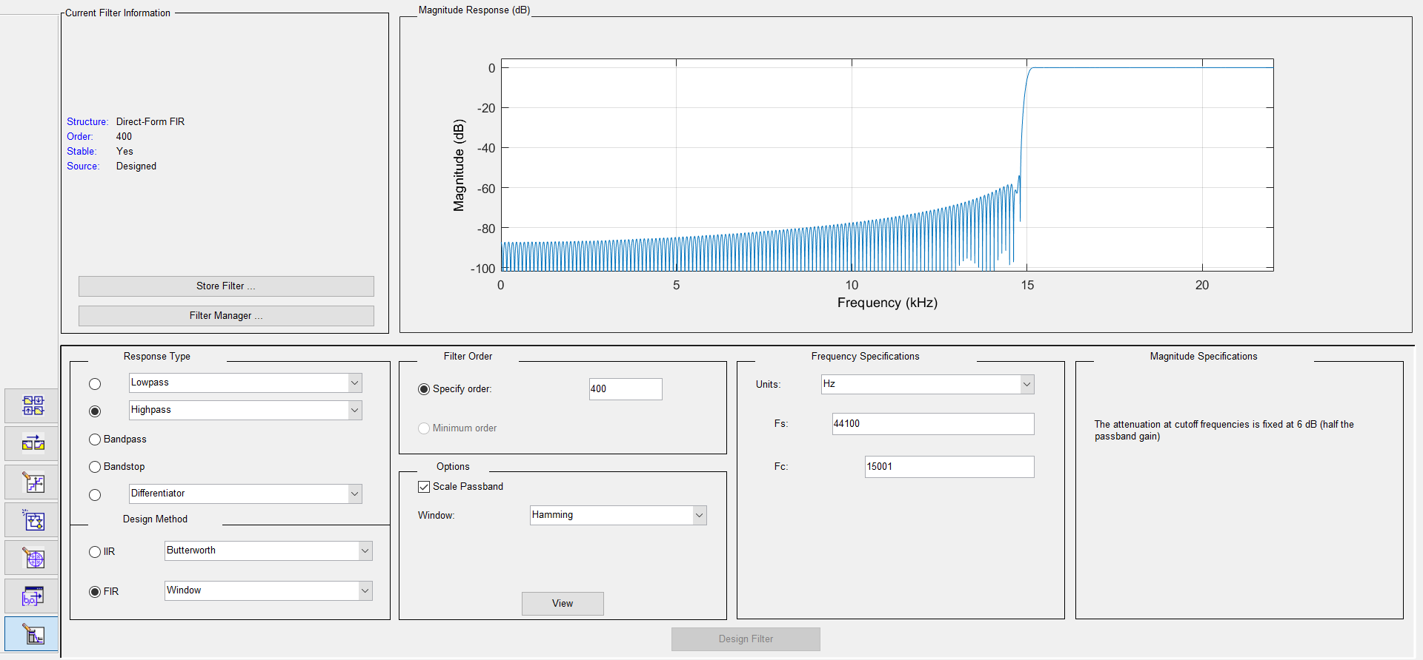
Highpass (>15 KHz)

Slide 14
Source Code

Slide 15
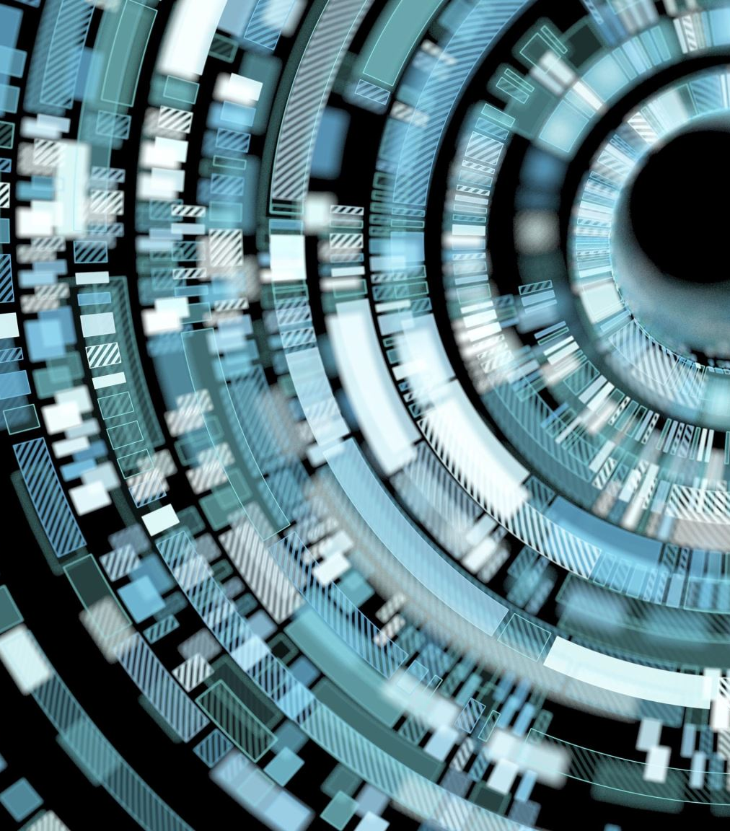
GUI Interface

Slide 16
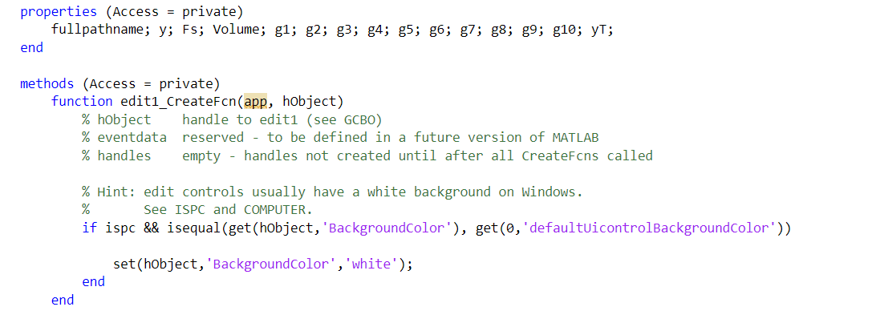

Slide 17
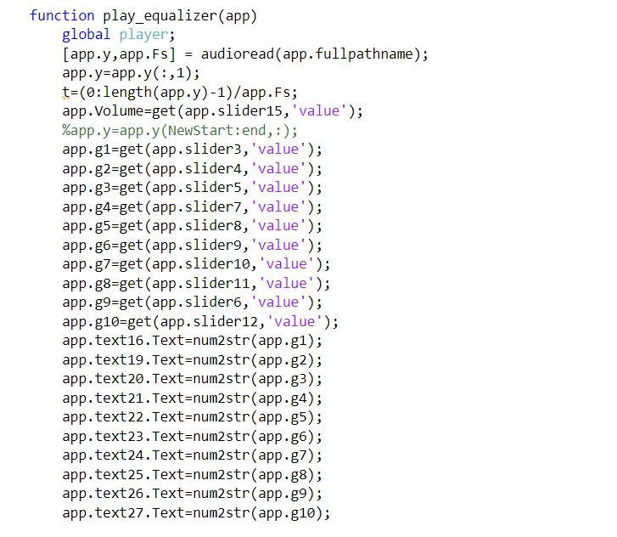

Slide 18
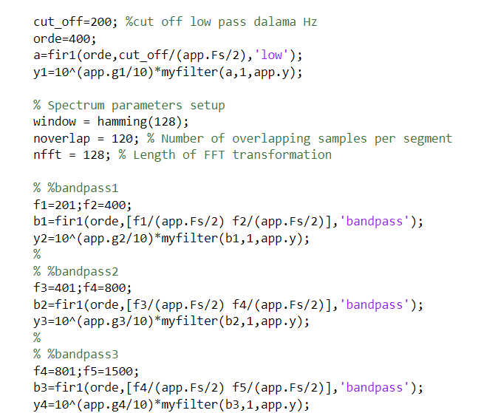

Slide 19
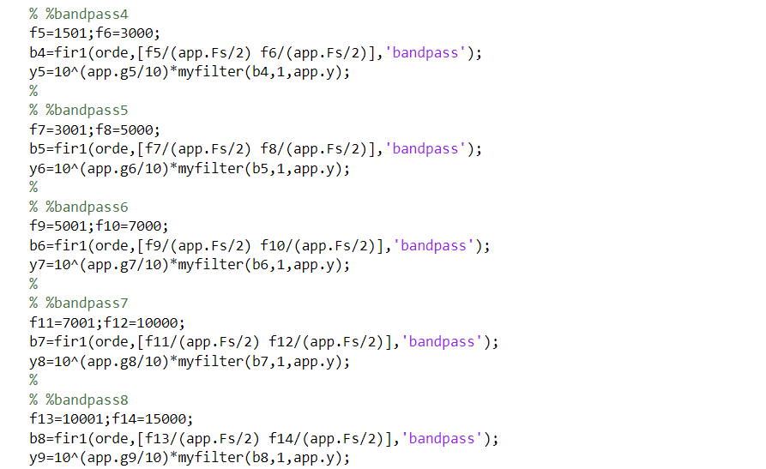

Slide 20
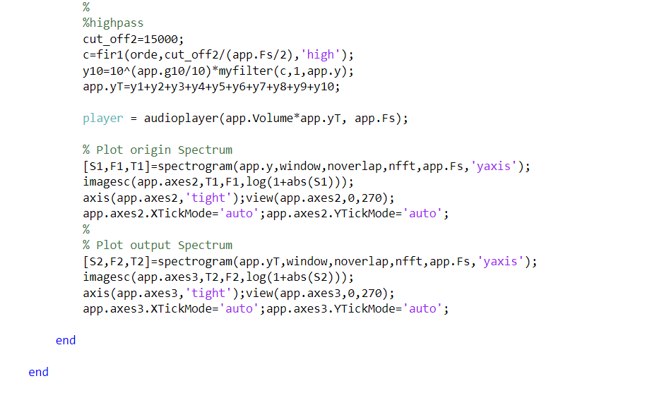

Slide 21
My Filter

Slide 22
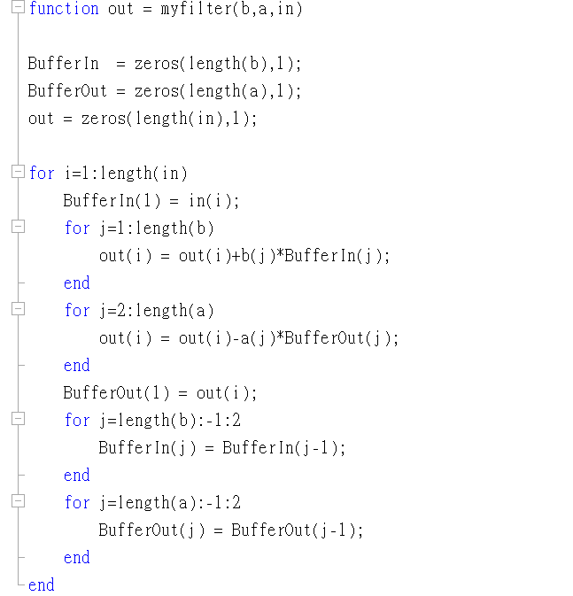

Slide 23
Original Audio File

Slide 24
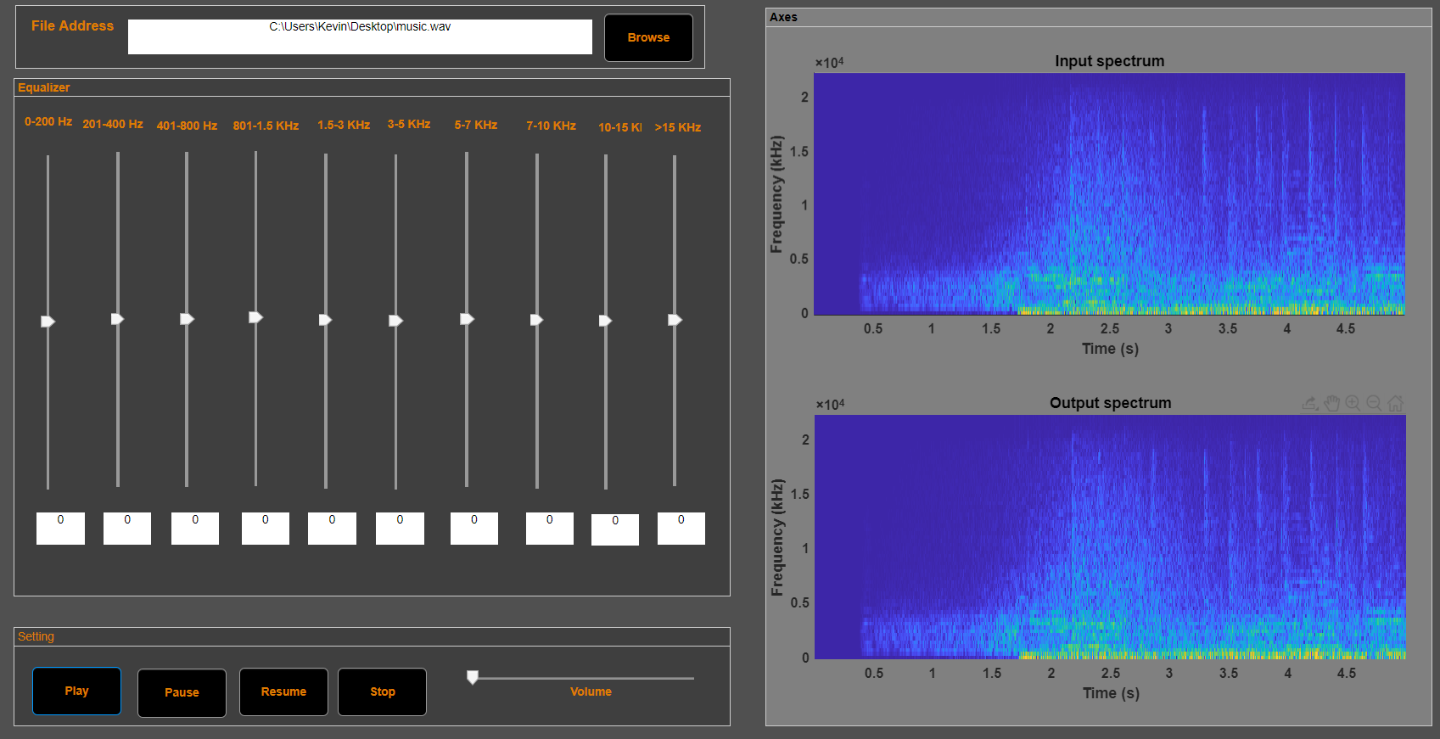


Slide 25
Audio File after Equalizer

Slide 26
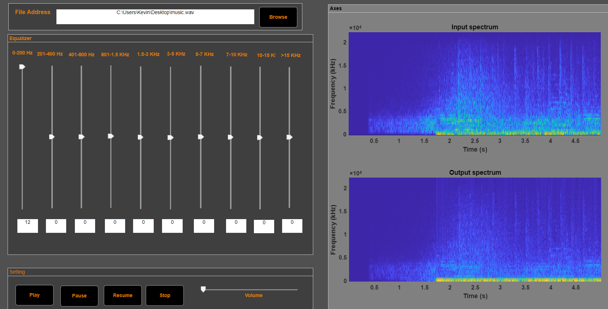

Slide 27
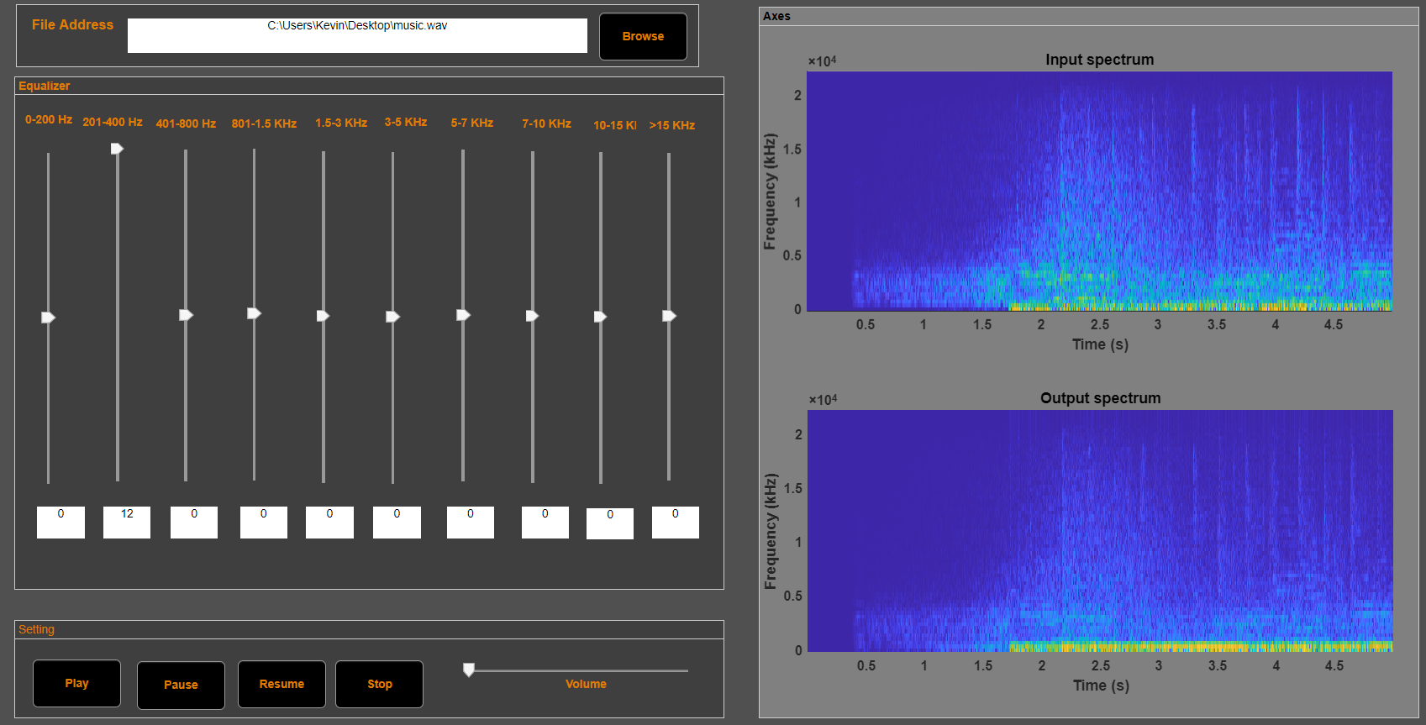

Slide 28
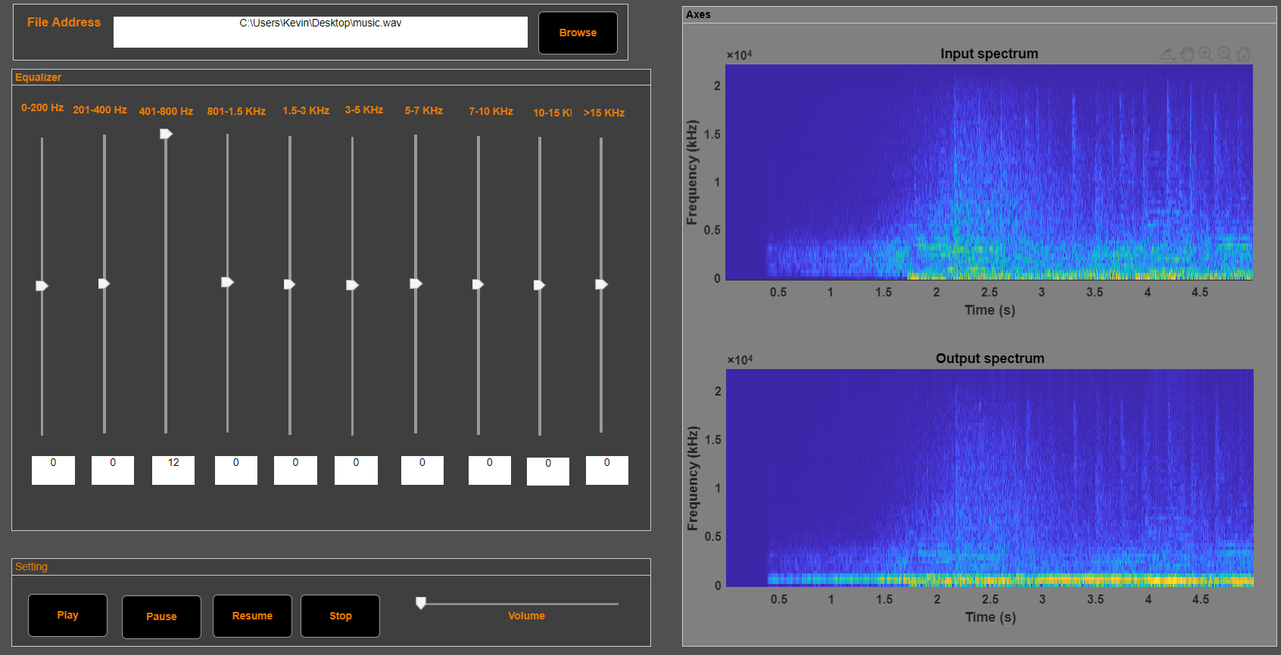

Slide 29
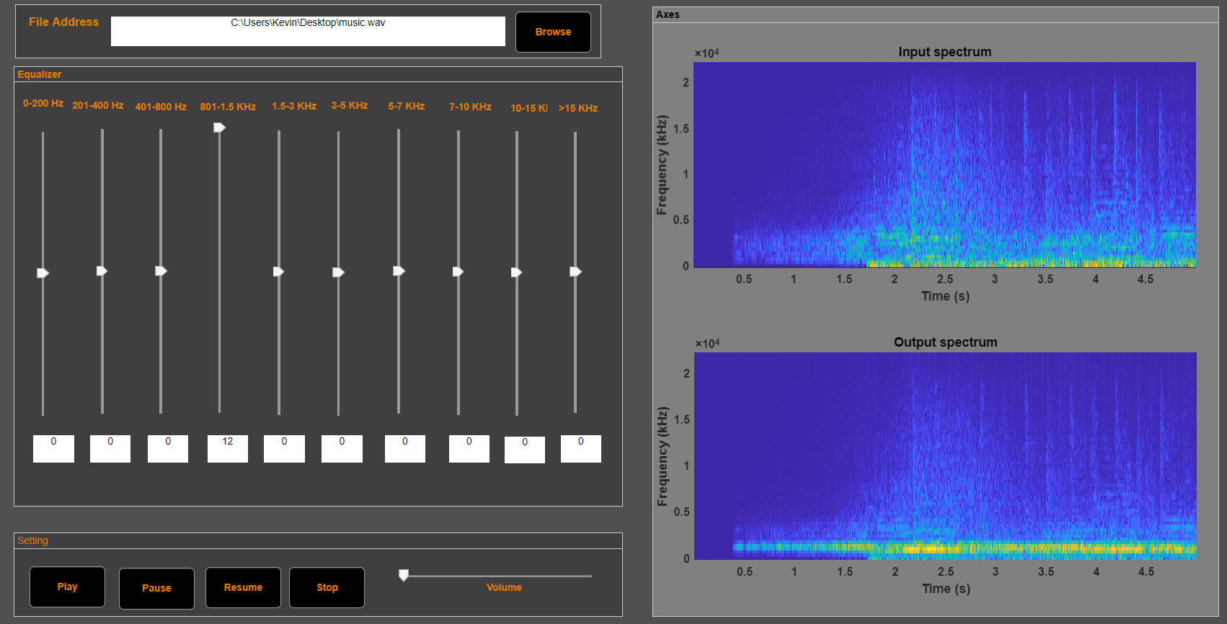

Slide 30
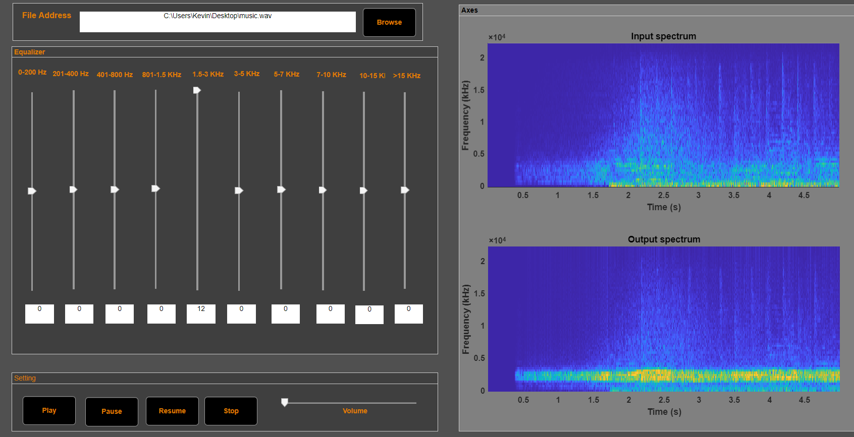

Slide 31
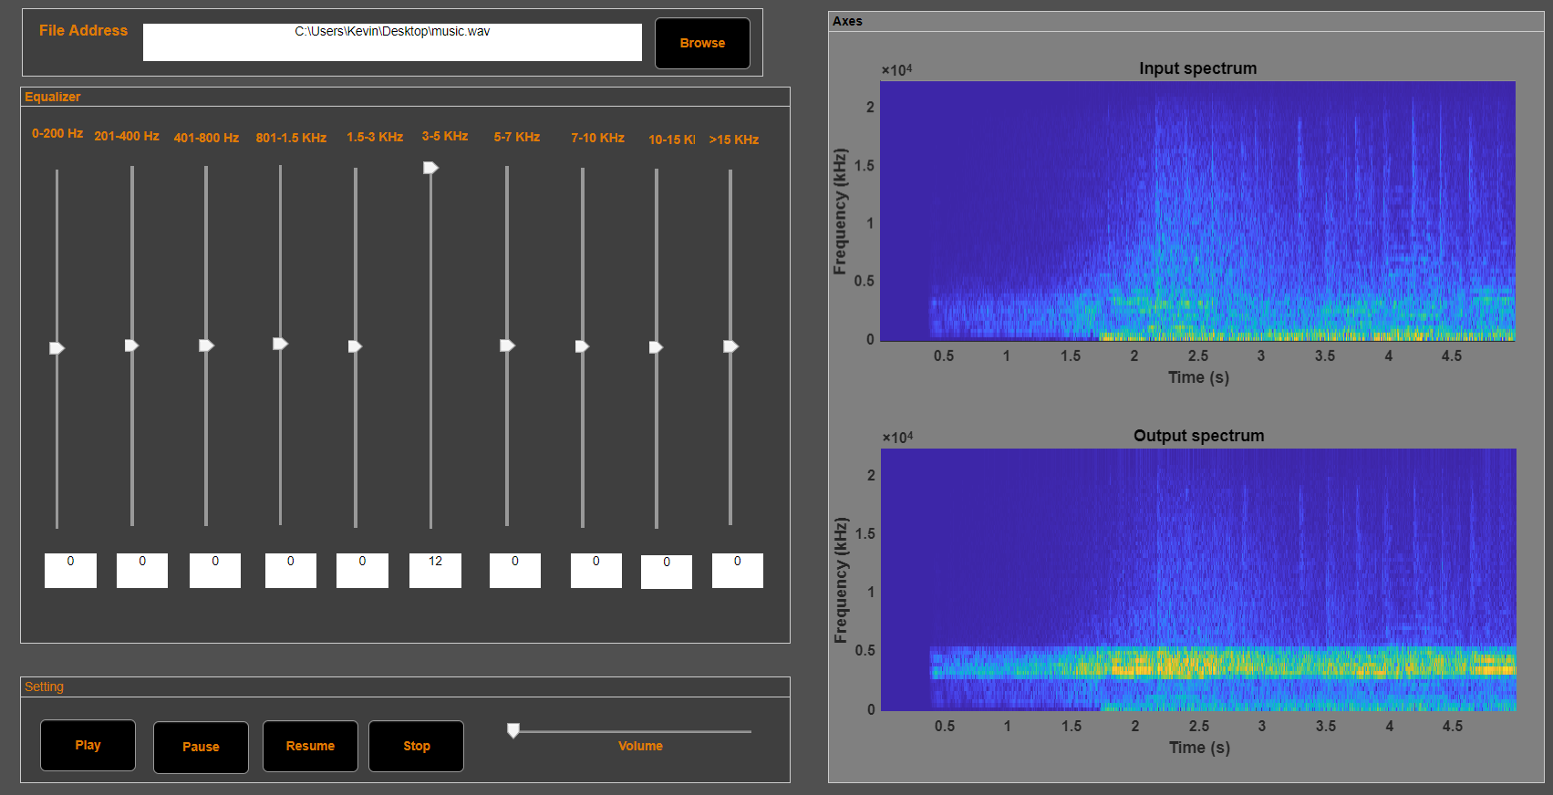

Slide 32
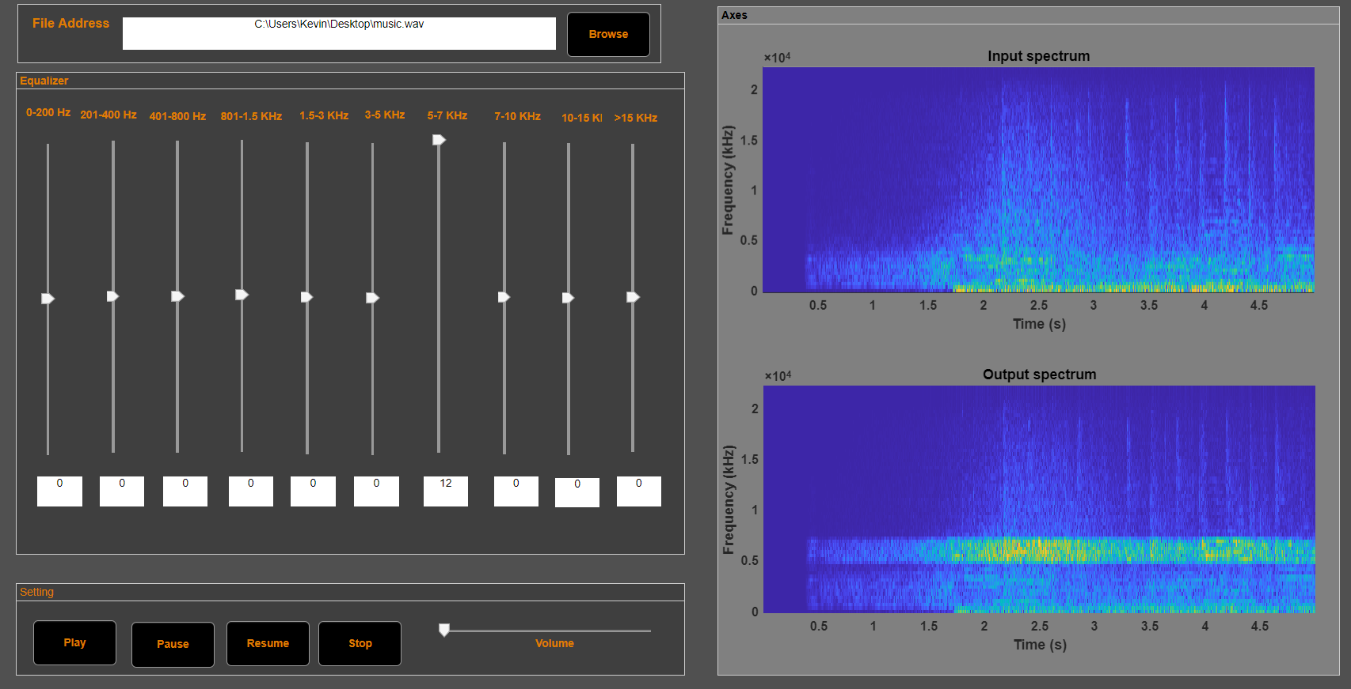

Slide 33
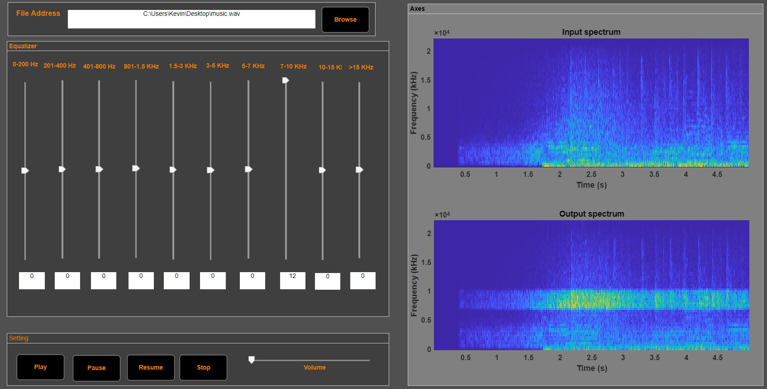

Slide 34
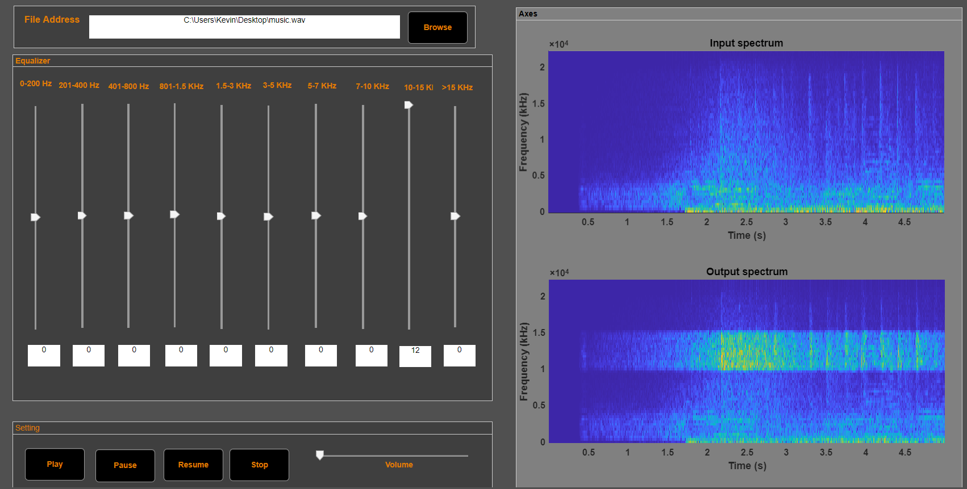

Slide 35
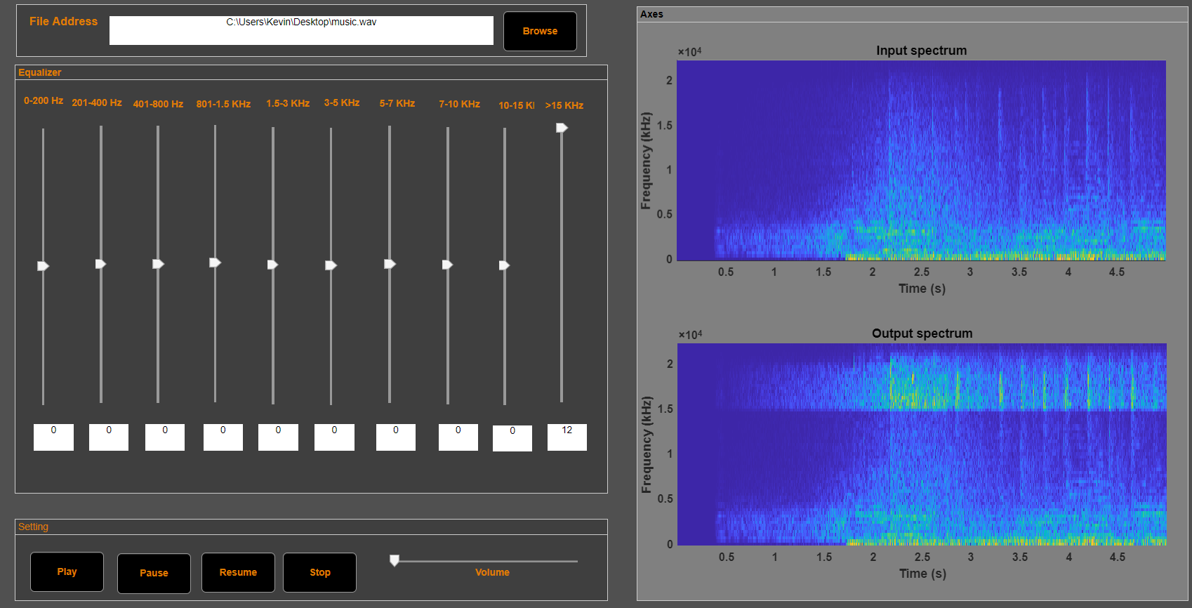

Slide 36
